Slide 1

COM1032: MOBILE COMPUTING - 2019/0
Lecture 6
Memory Management & Virtual
Memory
Dr. Manal Helal

Slide 2
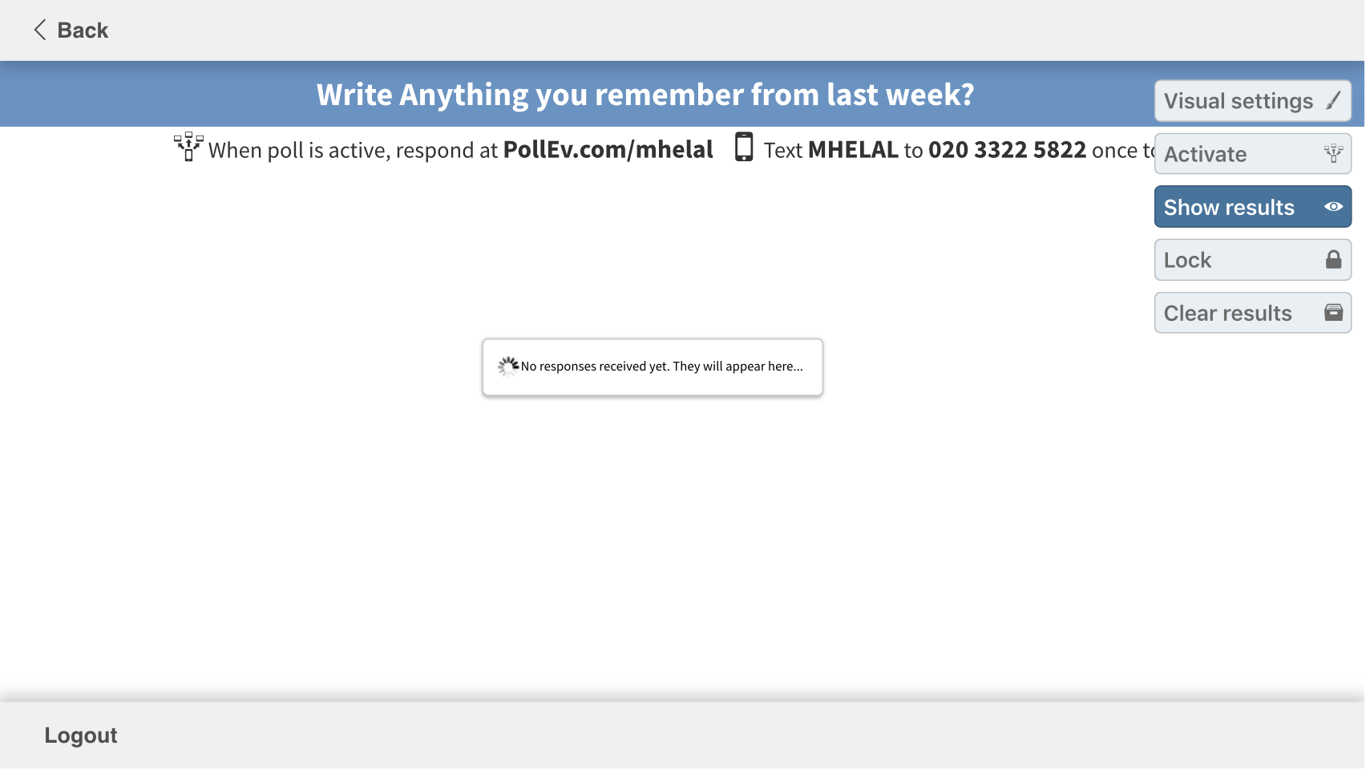

Slide 3
Last Week Summary
Important Definitions:
  Atomicity, Deadlock, Livelock, Critical Section, Mutual Exclusion,
Synchronisation Constructs:
  Mutex: Semaphores and synchronised keyword, Monitor, locks and conditions
Deadlock Avoidance, Prevention and Recovery and use cases for your review

Slide 4
Learning Outcomes
 |  | Attributes Developed
001 | Memory Allocation & Relocation | KPTC
002 | Paging & Segmentation | KC
003 | Mapping Logical Addresses to Physical Addresses | KC
004 | Virtual Memory Employment | KC
Attributes Developed
C - Cognitive/analytical T - Transferable skills
K - Subject knowledge P - Professional/Practical skills

Slide 5
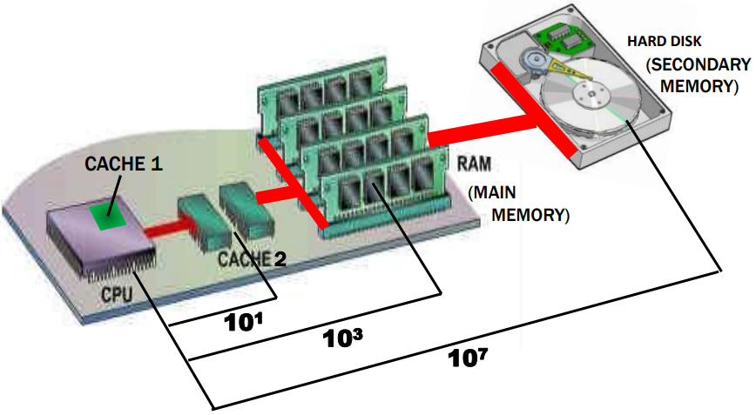
Outline
Memory Definitions
  Stack vs. Heap
  Memory Hierarchy
Memory Management Requirements
  Relocation
  Protection
  Sharing
  Logical organization
  Physical organization
  Memory Partitioning
Virtual Memory
  Hardware and control Structures
  Segmentation
  Paging
  Protection and Sharing
Case Studies
Approximate number of clock cycles to access the memory element

Slide 6
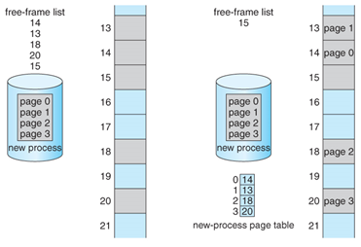
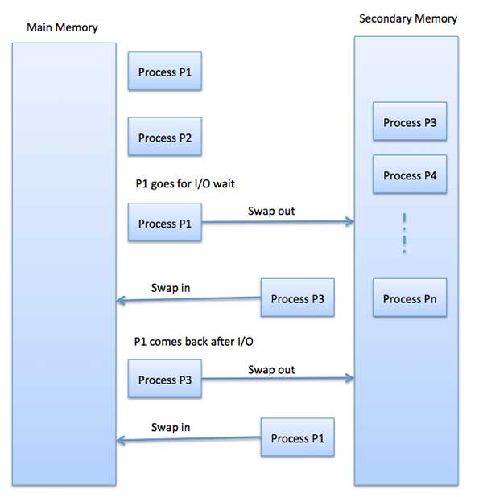
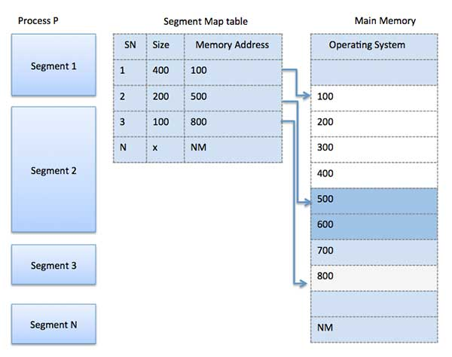
Process Pages Addressing
Memory Management
Process Segmentation Addressing

Slide 7
Calling Methods, cont.

Slide 8
Call Stacks

Slide 9
Trace Call Stack
i is declared and initialized

Slide 10
Trace Call Stack
j is declared and initialized

Slide 11
Trace Call Stack
Declare k

Slide 12
Trace Call Stack
Invoke max(i, j)

Slide 13
Trace Call Stack
pass the values of i and j to num1 and num2

Slide 14
Trace Call Stack
Declare result

Slide 15
Trace Call Stack
(num1 > num2) is true

Slide 16
Trace Call Stack
Assign num1 to result

Slide 17
Trace Call Stack
Return result and assign it to k

Slide 18
Trace Call Stack
Execute print statement

Slide 19
Stack | Heap
Static memory allocation | dynamic memory allocation
very fast access | (relatively) slower access
don't have to explicitly de-allocate variables | you must manage memory (you're in charge of allocating and freeing variables)
space is managed efficiently by CPU, memory will not become fragmented | no guaranteed efficient use of space, memory may become fragmented over time as blocks of memory are allocated, then freed
local variables only | variables can be accessed globally
limit on stack size (OS-dependent) | no limit on memory size
variables cannot be resized | variables can be resized using realloc()
is a "LIFO" (last in, first out) data structure, that is managed and optimized by the CPU | free-floating region of memory (and is larger)
Notes:
Thus, we cannot know ahead of time where a program will be placed, and we must allow for the possibility that the program may be moved about in main memory due to swapping. These facts raise some technical concerns related to addressing, as illustrated in Figure 7.1 . The figure depicts a process image. For simplicity, let us assume that the process image occupies a contiguous region of main memory. Clearly, the operating system will need to know the location of process control information and of the execution stack, as well as the entry point to begin execution of the program for this process. Because the operating system is managing memory and is responsible for bringing this process into main memory, these addresses are easy to come by. In addition, however, the processor must deal with memory references within the program. Branch instructions contain an address to reference the instruction to be executed next. Data reference instructions contain the address of the byte or word of data referenced. Somehow, the processor hardware and operating system software must be able to translate the memory references found in the code of the program into actual physical memory addresses, reflecting the current location of the program in main memory.

Slide 20
Outline
Memory Definitions
  Stack vs. Heap
  Memory Hierarchy
Memory Management Requirements
  Relocation
  Protection
  Sharing
  Logical organization
  Physical organization
  Memory Partitioning
Virtual Memory
  Hardware and control Structures
  Segmentation
  Paging
  Protection and Sharing
Case Studies
Approximate number of clock cycles to access the memory element

Slide 21
Memory Hierarchy
Design constraints on a computer’s memory
    How much?
    How fast?
    How expensive?
If the capacity is there, applications will likely be developed to use it
Memory must be able to keep up with the processor
Cost of memory must be reasonable in relationship to the other components
Notes:
The design constraints on a computer’s memory can be summed up by three questions: How much? How fast? How expensive?
The question of how much is somewhat open ended. If the capacity is there, applications will likely be developed to use it. The question of how fast is, in a sense, easier to answer. To achieve greatest performance, the memory must be able to keep up with the processor. That is, as the processor is executing instructions, we would not want it to have to pause waiting for instructions or operands. The final question must also be considered. For a practical system, the cost of memory must be reasonable in relationship to other components.

Slide 22
The Memory Hierarchy
Going down the hierarchy:
  Decreasing cost per bit
  Increasing capacity
  Increasing access time
  Decreasing frequency of access to the memory by the processor
Notes:
The way out of this dilemma is to not rely on a single memory component or technology, but to employ a memory hierarchy . A typical hierarchy is illustrated in
Figure 1.14 . As one goes down the hierarchy, the following occur:
a. Decreasing cost per bit
b. Increasing capacity
c. Increasing access time
d. Decreasing frequency of access to the memory by the processor
Thus, smaller, more expensive, faster memories are supplemented by larger, cheaper, slower memories. The key to the success of this organization is the decreasing
frequency of access at lower levels. We will examine this concept in greater detail later in this chapter, when we discuss the cache, and when we discuss virtual
memory later in this book. A brief explanation is provided at this point.
Suppose that the processor has access to two levels of memory. Level 1 contains 1,000 bytes and has an access time of 0.1 μs; level 2 contains 100,000 bytes and has an access time of 1 μs. Assume that if a byte to be accessed is in level 1, then the processor accesses it directly. If it is in level 2, then the byte is first transferred to level 1 and then accessed by the processor. For simplicity, we ignore the time required for the processor to determine whether the byte is in level 1 or level 2.

Slide 23
Principle of Locality
Memory references by the processor tend to cluster
Data is organized so that the percentage of accesses to each successively lower level is substantially less than that of the level above
Can be applied across more than two levels of memory
Notes:
A principle known as locality of reference [DENN68]. During the course of execution of a program, memory references by the processor, for both instructions and data, tend to cluster. Programs typically contain a number of iterative loops and subroutines. Once a loop or subroutine is entered, there are repeated references to a small set of instructions. Similarly, operations on tables and arrays involve access to a clustered set of data bytes. Over a long period of time, the clusters in use change, but over a short period of time, the processor is primarily working with fixed clusters of memory references.
Accordingly, it is possible to organize data across the hierarchy such that the percentage of accesses to each successively lower level is substantially less than that of the level above. Consider the two-level example already presented. Let level 2 memory contain all program instructions and data. The current clusters can be temporarily placed in level 1. From time to time, one of the clusters in level 1 will have to be swapped back to level 2 to make room for a new cluster coming in to level 1. On average, however, most references will be to instructions and data contained in level 1.
This principle can be applied across more than two levels of memory. The fastest, smallest, and most expensive type of memory consists of the registers internal to the processor. Typically, a processor will contain a few dozen such registers, although some processors contain hundreds of registers. Skipping down two levels, main memory is the principal internal memory system of the computer. Each location in main memory has a unique address, and most machine instructions refer to one or more main memory addresses. Main memory is usually extended with a higher-speed, smaller cache. The cache is not usually visible to the programmer or, indeed, to the processor. It is a device for staging the movement of data between main memory and processor registers to improve performance.
Although cache memory is invisible to the OS, it interacts with other memory management hardware. Furthermore, many of the principles used in virtual memory schemes (discussed in Chapter 8 ) are also applied in cache memory.
On all instruction cycles, the processor accesses memory at least once, to fetch the instruction, and often one or more additional times, to fetch operands and/ or store results. The rate at which the processor can execute instructions is clearly limited by the memory cycle time (the time it takes to read one word from or write one word to memory). This limitation has been a significant problem because of the persistent mismatch between processor and main memory speeds: Over the years, processor speed has consistently increased more rapidly than memory access speed. We are faced with a trade-off among speed, cost, and size. Ideally, main memory should be built with the same technology as that of the processor registers, giving memory cycle times comparable to processor cycle times. This has always been too expensive a strategy. The solution is to exploit the principle of locality by providing a small, fast memory between the processor and main memory, namely the cache.

Slide 24
Notes:
Cache memory is intended to provide memory access time approaching that of the fastest memories available and at the same time support a large memory size that has the price of less expensive types of semiconductor memories. The concept is illustrated in Figure 1.16a . There is a relatively large and slow main memory together with a smaller, faster cache memory. The cache contains a copy of a portion of main memory. When the processor attempts to read a byte or word of memory, a check is made to determine if the byte or word is in the cache. If so, the byte or word is delivered to the processor. If not, a block of main memory, consisting of some fixed number of bytes, is read into the cache and then the byte or word is delivered to
the processor. Because of the phenomenon of locality of reference, when a block of data is fetched into the cache to satisfy a single memory reference, it is likely that many of the near-future memory references will be to other bytes in the block.
Figure 1.16b depicts the use of multiple levels of cache. The L2 cache is slower and typically larger than the L1 cache, and the L3 cache is slower and typically larger than the L2 cache.

Slide 25
The cache tag identifies which particular block is currently being stored.
A Mapping Function determines which cache location the block will occupy
(C<<M)
Notes:
Figure 1.17 depicts the structure of a cache/main memory system. Main memory consists of up to 2 ^{n} addressable words, with each word having a unique n –bit address. For mapping purposes, this memory is considered to consist of a number of fixed-length blocks of K words each. "Word size" refers to the number of bits processed by a computer's CPU in one go (these days, typically 32 bits or 64 bits).
That is, there are M = 2^{n}/K blocks. Cache consists of C slots (also referred to as lines ) of K words each, and the number of slots is considerably less than the number of main memory blocks (C<<M) . Some subset of the blocks of main memory resides in the slots of the cache. If a word in a block of memory that is not in the cache is read, that block is transferred to one of the slots of the cache. Because there are more blocks than slots, an individual slot cannot be uniquely and permanently dedicated to a particular block. Therefore, each slot includes a tag that identifies which particular block is currently being stored. The tag is usually some number of higher-order bits of the address and refers to all addresses that begin with that sequence of bits.
Figure 1.18 illustrates the read operation. The processor generates the address, RA, of a word to be read. If the word is contained in the cache, it is delivered to the processor. Otherwise, the block containing that word is loaded into the cache and the word is delivered to the processor.
A detailed discussion of cache design is beyond the scope of this book. Key elements are briefly summarized here. We will see that similar design issues must be addressed in dealing with virtual memory and disk cache design. They fall into the following categories:
• Cache size
• Block size
• Mapping function
• Replacement algorithm
• Write policy
• Number of cache levels
We have already dealt with the issue of cache size . It turns out that reasonably small caches can have a significant impact on performance. Another size issue is that of block size : the unit of data exchanged between cache and main memory. As the block size increases from very small to larger sizes, the hit ratio will at first increase because of the principle of locality: the high probability that data in the vicinity of a referenced word are likely to be referenced in the near future. As the block size increases, more useful data are brought into the cache. The hit ratio will begin to decrease, however, as the block becomes even bigger and the probability of using the newly fetched data becomes less than the probability of reusing the data that have to be moved out of the cache to make room for the new block.
When a new block of data is read into the cache, the mapping function determines which cache location the block will occupy. Two constraints affect the design of the mapping function. First, when one block is read in, another may have to be replaced. We would like to do this in such a way as to minimize the probability that we will replace a block that will be needed in the near future. The more flexible the mapping function, the more scope we have to design a replacement algorithm to maximize the hit ratio. Second, the more flexible the mapping function, the more complex is the circuitry required to search the cache to determine if a given block is in the cache.

Slide 26
Replacement Algorithm
Least Recently Used (LRU) Algorithm
  Effective strategy is to replace a block that has been in the cache the longest with no references to it
  Hardware mechanisms are needed to identify the least recently used block
Chooses which block to replace when a new block is to be loaded into the cache
Write Policy: Dictates when the memory write operation takes place
  Can occur every time the block is updated or replaced
    Minimizes write operations
    Leaves main memory in an obsolete state
Notes:
The replacement algorithm chooses, within the constraints of the mapping function, which block to replace when a new block is to be loaded into the cache and the cache already has all slots filled with other blocks. We would like to replace the block that is least likely to be needed again in the near future. Although it is impossible to identify such a block, a reasonably effective strategy is to replace the block that has been in the cache longest with no reference to it. This policy is referred to as the least-recently-used (LRU) algorithm. Hardware mechanisms are needed to identify the least-recently-used block.
If the contents of a block in the cache are altered, then it is necessary to write it back to main memory before replacing it. The write policy dictates when the memory write operation takes place. At one extreme, the writing can occur every time that the block is updated. At the other extreme, the writing occurs only when the block is replaced. The latter policy minimizes memory write operations but leaves main memory in an obsolete state. This can interfere with multiple-processor operation and with direct memory access by I/O hardware modules.
Finally, it is now commonplace to have multiple levels of cache, labeled L1
(cache closest to the processor), L2, and in many cases a third level L3. A discussion
of the performance benefits of multiple cache levels is beyond our scope; see
[STAL16] for a discussion.

Slide 27
Outline
Memory Definitions
  Stack vs. Heap
  Memory Hierarchy
Memory Management Requirements
  Relocation
  Protection
  Sharing
  Logical organization
  Physical organization
  Memory Partitioning
Virtual Memory
  Hardware and control Structures
  Segmentation
  Paging
  Protection and Sharing
Case Studies
Approximate number of clock cycles to access the memory element

Slide 28
Memory Management Definition
Memory Management is the process of main memory dynamic partitioning:
  one part for the operating system (resident monitor, kernel)
  another part for the program currently being executed (the “user” part of memory )
  In a multiprogramming system, user memory must be further subdivided to accommodate multiple processes.
Keeping the processor always busy, a large pool of processes need to be in memory in the ready queue, such that when a few processes blocks for I/O, another one starts.
Frame | A fixed-length block of main memory.
Page | A fixed-length block of data that resides in secondary memory (such as disk). A page of data may temporarily be copied into a frame of main memory.
Segment | A variable-length block of data that resides in secondary memory. An entire segment may temporarily be copied into an available region of main memory (segmentation) or the segment may be divided into pages which can be individually copied into main memory (combined segmentation and paging).

Slide 29
Memory Tables
Used to keep track of both main (real) and secondary (virtual) memory
Processes are maintained on secondary memory using some sort of virtual memory or simple swapping mechanism
Must include:
Allocation of main memory to processes
Allocation of secondary memory to processes
Protection attributes of blocks of main or virtual memory
Information needed to manage virtual memory
Notes:
Memory tables are used to keep track of both main (real) and secondary
(virtual) memory. Some of main memory is reserved for use by the OS; the
remainder is available for use by processes. Processes are maintained on secondary
memory using some sort of virtual memory or simple swapping mechanism. The
memory tables must include the following information:
• The allocation of main memory to processes
• The allocation of secondary memory to processes
Any protection attributes of blocks of main or virtual memory, such as which
processes may access certain shared memory regions
• Any information needed to manage virtual memory
We examine the information structures for memory management in detail in Part
Three.

Slide 30
Memory Management Requirements
Memory management is intended to satisfy the following requirements:
Relocation: swap out and in to different locations
Protection: permissions and access restrictions to other processes blocks
Sharing: examples: several processes from one program, dynamic link libraries
Logical organization
Physical organization
Notes:
While surveying the various mechanisms and policies associated with memory management, it is helpful to keep in mind the requirements that memory management is intended to satisfy. These requirements include the following:
• Relocation
In a multiprogramming system, the available main memory is generally shared among a number of processes. Typically, it is not possible for the programmer to know in advance which other programs will be resident in main memory at the time of execution of his or her program. In addition, we would like to be able to swap active processes in and out of main memory to maximize processor utilization by providing a large pool of ready processes to execute. Once a program is swapped out to disk, it would be quite limiting to specify that when it is next swapped back in, it must be placed in the same main memory region as before. Instead, we may need to relocate the process to a different area of memory.
• Protection
Each process should be protected against unwanted interference by other processes, whether accidental or intentional. Thus, programs in other processes should not be able to reference memory locations in a process for reading or writing purposes without permission. In one sense, satisfaction of the relocation requirement increases the difficulty of satisfying the protection requirement. Because the location of a program in main memory is unpredictable, it is impossible to check absolute addresses at compile time to assure protection. Furthermore, most programming languages allow the dynamic calculation of addresses at run time (e.g., by computing an array subscript or a pointer into a data structure). Hence all
memory references generated by a process must be checked at run time to ensure that they refer only to the memory space allocated to that process. Fortunately, we shall see that mechanisms that support relocation also support the protection requirement.
Normally, a user process cannot access any portion of the operating system, neither program nor data. Again, usually a program in one process cannot branch to an instruction in another process. Without special arrangement, a program in one process cannot access the data area of another process. The processor must be able to abort such instructions at the point of execution.
Note that the memory protection requirement must be satisfied by the processor (hardware) rather than the operating system (software). This is because the OS cannot anticipate all of the memory references that a program will make. Even if such anticipation were possible, it would be prohibitively time consuming to screen each program in advance for possible memory-reference violations. Thus, it is only possible to assess the permissibility of a memory reference (data access or branch) at the time of execution of the instruction making the reference. To accomplish this, the processor hardware must have that capability.
• Sharing
Any protection mechanism must have the flexibility to allow several processes to access the same portion of main memory. For example, if a number of processes are executing the same program, it is advantageous to allow each process to access the same copy of the program rather than have its own separate copy. Processes that are cooperating on some task may need to share access to the same data structure. The memory management system must therefore allow controlled access to shared areas of memory without compromising essential protection. Again, we will see that the mechanisms used to support relocation support sharing capabilities.
• Logical organization
• Physical organization

Slide 31
Logical Organization
Memory is organized as linear
Segmentation is the tool that most readily satisfies requirements
Programs are written in modules
Modules can be written and compiled independently
Different degrees of protection given to modules (read-only, execute-only)
Sharing on a module level corresponds to the user’s way of viewing the problem
Notes:
Almost invariably, main memory in a computer system is organized as a linear, or one-dimensional, address space, consisting of a sequence of bytes or words. Secondary memory, at its physical level, is similarly organized. While this organization closely mirrors the actual machine hardware, it does not correspond to the way in which programs are typically constructed. Most programs are organized into modules, some of which are unmodifiable (read only, execute only) and some of which contain data that may be modified. If the operating system and computer hardware can effectively deal with user programs and data in the form of modules of some sort, then a number of advantages can be realized:
1. Modules can be written and compiled independently, with all references from
one module to another resolved by the system at run time.
2. With modest additional overhead, different degrees of protection (read only,
execute only) can be given to different modules.
3. It is possible to introduce mechanisms by which modules can be shared among
processes. The advantage of providing sharing on a module level is that this corresponds to the user’s way of viewing the problem, and hence it is easy for
the user to specify the sharing that is desired.
The tool that most readily satisfies these requirements is segmentation, which is one of the memory management techniques explored in this chapter.

Slide 32
Physical Organization
Cannot leave the programmer with the responsibility to manage memory
Memory available for a program plus its data may be insufficient
Overlaying allows various modules to be assigned the same region of memory but is time consuming to program
Programmer does not know how much space will be available
Notes:
As we discussed in Section 1.5 , computer memory is organized into at least two levels, referred to as main memory and secondary memory. Main memory provides fast access at relatively high cost. In addition, main memory is volatile; that is, it does not provide permanent storage. Secondary memory is slower and cheaper than main memory and is usually not volatile. Thus secondary memory of large capacity can be provided for long-term storage of programs and data, while a smaller main memory holds programs and data currently in use.
In this two-level scheme, the organization of the flow of information between main and secondary memory is a major system concern. The responsibility for this flow could be assigned to the individual programmer, but this is impractical and undesirable for two reasons:
1. The main memory available for a program plus its data may be insufficient. In
that case, the programmer must engage in a practice known as overlaying , in which the program and data are organized in such a way that various modules can be assigned the same region of memory, with a main program responsible for switching the modules in and out as needed. Even with the aid of compiler tools, overlay programming wastes programmer time.
2. In a multiprogramming environment, the programmer does not know at the time of coding how much space will be available or where that space will be.
It is clear, then, that the task of moving information between the two levels of memory should be a system responsibility. This task is the essence of memory management.

Slide 33
Outline
Memory Definitions
  Stack vs. Heap
  Memory Hierarchy
Memory Management Requirements
  Relocation
  Protection
  Sharing
  Logical organization
  Physical organization
  Memory Partitioning
Virtual Memory
  Hardware and control Structures
  Segmentation
  Paging
  Protection and Sharing
Case Studies
Approximate number of clock cycles to access the memory element

Slide 34
Memory Partitioning
Memory management brings processes into main memory for execution by the processor
          Involves virtual memory
      Based on segmentation and paging
    Partitioning
          Used in several variations in some now-obsolete operating systems
          Does not involve virtual memory
Notes:
The principal operation of memory management is to bring processes into main memory for execution by the processor. In almost all modern multiprogramming systems, this involves a sophisticated scheme known as virtual memory. Virtual memory is, in turn, based on the use of one or both of two basic techniques: segmentation and paging. Before we can look at these virtual memory techniques, we must prepare the ground by looking at simpler techniques that do not involve virtual memory ( Table 7.2 summarizes all the techniques examined in this chapter and the next). One of these techniques, partitioning, has been used in several variations in some now-obsolete operating systems. The other two techniques, simple paging and simple segmentation, are not used by themselves. However, it will clarify the discussion of virtual memory if we look first at these two techniques in the absence of virtual memory considerations.

Slide 35
Memory Management Techniques
Fixed Partitioning Sizes
(Table is on page 317 in textbook)
Notes:
Table 7.2 Memory Management Techniques
In most schemes for memory management, we can assume that the OS occupies some fixed portion of main memory and that the rest of main memory is available for use by multiple processes. The simplest scheme for managing this available memory is to partition it into regions with fixed boundaries.
PARTITION SIZES Figure 7.2 shows examples of two alternatives for fixed partitioning. One possibility is to make use of equal-size partitions. In this case, any process whose size is less than or equal to the partition size can be loaded into any available partition. If all partitions are full and no process is in the Ready or Running state, the operating system can swap a process out of any of the partitions and load in another process, so that there is some work for the processor.

Slide 36
Fixed Partitioning Disadvantages
A program may be too big to fit in a partition
    Program needs to be designed with the use of overlays
Main memory utilization is inefficient
    Any program, regardless of size, occupies an entire partition
    Internal fragmentation
      Wasted space due to the block of data loaded being smaller than the partition
The number of partitions specified at system generation time limits the number of active processes in the system
Small jobs will not utilize partition space efficiently
Notes:
There are two difficulties with the use of equal-size fixed partitions:
• A program may be too big to fit into a partition. In this case, the programmer must design the program with the use of overlays so that only a portion of the program need be in main memory at any one time. When a module is needed that is not present, the user’s program must load that module into the program’s partition, overlaying whatever programs or data are there.
• Main memory utilization is extremely inefficient. Any program, no matter how small, occupies an entire partition. In our example, there may be a program whose length is less than 2 Mbytes; yet it occupies an 8-Mbyte partition whenever it is swapped in. This phenomenon, in which there is wasted space internal to a partition due to the fact that the block of data loaded is smaller than the partition, is referred to as internal fragmentation .
The use of unequal-size partitions provides a degree of flexibility to fixed partitioning. In addition, it can be said that fixed-partitioning schemes are relatively simple and require minimal OS software and processing overhead. However, there are disadvantages:
• The number of partitions specified at system generation time limits the number of active (not suspended) processes in the system.
• Because partition sizes are preset at system generation time, small jobs will not utilize partition space efficiently. In an environment where the main storage requirement of all jobs is known beforehand, this may be reasonable, but in most cases, it is an inefficient technique.

Slide 37
Dynamic Partitioning
Partitions are of variable length and number
Process is allocated exactly as much memory as it requires
This technique was used by IBM’s mainframe operating system, OS/MVT
Notes:
To overcome some of the difficulties with fixed partitioning, an approach known as dynamic partitioning was developed. Again, this approach has been supplanted by more sophisticated memory management techniques. An important operating system that used this technique was IBM’s mainframe operating system, OS/MVT (Multiprogramming with a Variable Number of Tasks).
With dynamic partitioning, the partitions are of variable length and number. When a process is brought into main memory, it is allocated exactly as much memory as it requires and no more.
An example, using 64 Mbytes of main memory, is shown in Figure 7.4 . Initially, main memory is empty, except for the OS (a). The first three processes are loaded in, starting where the operating system ends and occupying just enough space for each process (b, c, d). This leaves a “hole” at the end of memory that is too small for a fourth process. At some point, none of
the processes in memory is ready. The operating system swaps out process 2 (e), which leaves sufficient room to load a new process, process 4 (f). Because process 4 is smaller than process 2, another small hole is created. Later, a point is reached at which none of the processes in main memory is ready, but process 2, in the Ready-Suspend state, is available. Because there is insufficient room in memory for process 2, the operating system swaps process 1 out (g) and swaps process 2 back in (h).
As this example shows, this method starts out well, but eventually it leads to a situation in which there are a lot of small holes in memory. As time goes on, memory becomes more and more fragmented, and memory utilization declines. This phenomenon is referred to as external fragmentation , indicating that the memory that is external to all partitions becomes increasingly fragmented. This is in contrast to internal fragmentation, referred to earlier.

Slide 38
Dynamic Partitioning
External Fragmentation
Memory becomes more and more fragmented
Memory utilization declines
Compaction
Technique for overcoming external fragmentation
OS shifts processes so that they are contiguous
Free memory is together in one block
Time consuming and wastes CPU time
Notes:
One technique for overcoming external fragmentation is compaction : From time to time, the OS shifts the processes so that they are contiguous and so that all of the free memory is together in one block. For example, in Figure 7.4h , compaction will result in a block of free memory of length 16M. This may well be sufficient to load in an additional process. The difficulty with compaction is that it is a time-consuming procedure and wasteful of processor time. Note that compaction implies the need for a dynamic relocation capability. That is, it must be possible to move a program from one region to another in main memory without invalidating the memory references in the program (see Appendix 7A).

Slide 39
Placement Algorithms
Best-fit
Chooses the block that is closest in size to the request
First-fit
Begins to scan memory from the beginning and chooses the first available block that is large enough
Next-fit
Begins to scan memory from the location of the last placement and chooses the next available block that is large enough
Notes:
Because memory compaction is time consuming, the OS designer must be clever in deciding how to assign processes to memory (how to plug the holes). When it is time to load or swap a process into main memory, and if there is more than one free block of memory of sufficient size, then the operating system must decide which free block to allocate.
Three placement algorithms that might be considered are best-fit, first-fit, and next-fit. All, of course, are limited to choosing among free blocks of main memory that are equal to or larger than the process to be brought in. Best-fit chooses the block that is closest in size to the request. First-fit begins to scan memory from the beginning and chooses the first available block that is large enough. Next-fit begins to scan memory from the location of the last placement, and chooses the next available block that is large enough.
Figure 7.5a shows an example memory configuration after a number of placement and swapping-out operations. The last block that was used was a 22-Mbyte block from which a 14-Mbyte partition was created. Figure 7.5b shows the difference between the best-, first-, and next-fit placement algorithms in satisfying a 16-Mbyte allocation request. Best-fit will search the entire list of available blocks and make use of the 18-Mbyte block, leaving a 2-Mbyte fragment. First-fit results in a 6-Mbyte fragment, and next-fit results in a 20-Mbyte fragment.
Which of these approaches is best will depend on the exact sequence of process swapping that occurs and the size of those processes. However, some general comments can be made (see also [BREN89], [SHOR75], and [BAYS77]). The first-fit algorithm is not only the simplest but usually the best and fastest as well. The next-fit algorithm tends to produce slightly worse results than the first-fit. The next-fit algorithm will more frequently lead to an allocation from a free block at the end of memory. The result is that the largest block of free memory, which usually appears at the end of the memory space, is quickly broken up into small fragments. Thus, compaction may be required more frequently with next-fit. On the other hand, the first-fit algorithm may litter the front end with small free partitions that need to be searched over on each subsequent first-fit pass. The best-fit algorithm, despite its name, is usually the worst performer. Because this algorithm looks for the smallest block that will satisfy the requirement, it guarantees that the fragment left behind is as small as possible. Although each memory request always wastes the smallest amount of memory, the result is that main memory is quickly littered by blocks too small to satisfy memory allocation requests. Thus, memory compaction must be done more frequently than with the other algorithms.

Slide 40
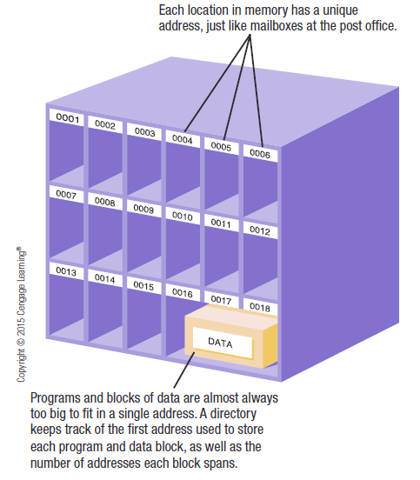
Addresses
Logical
Reference to a memory location independent of the current assignment of data to memory
Relative
A particular example of logical address, in which the address is expressed as a location relative to some known point
Physical or Absolute
Actual location in main memory
Notes:
A logical address is a reference to a memory location independent of the current assignment of data to memory; a translation must be made to a physical address before the memory access can be achieved. A relative address is a particular example of logical address, in which the address is expressed as a location relative to some known point, usually a value in a processor register. A physical address , or absolute address, is an actual location in main memory.

Slide 41
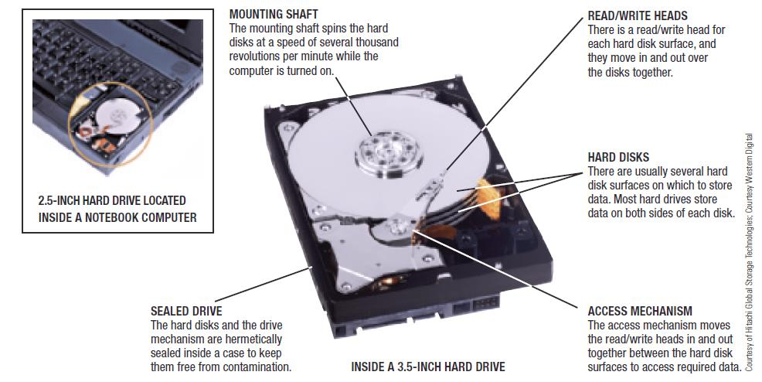
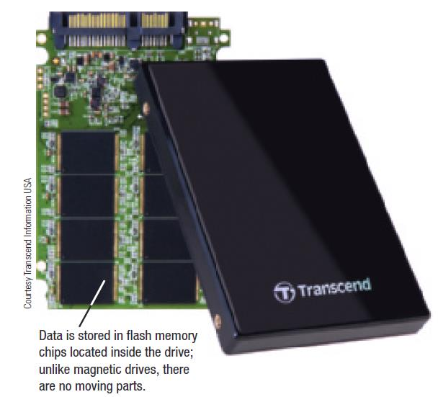
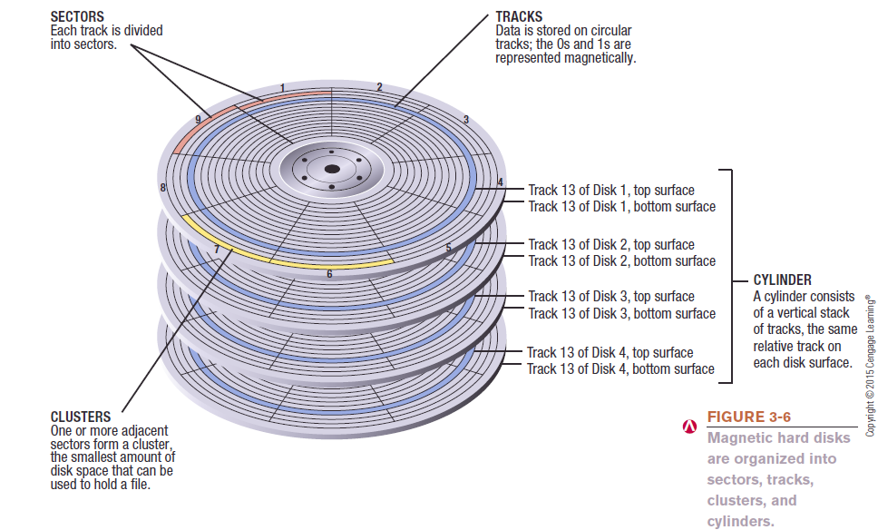
Solid State Drives (SSDs)

Slide 42
Notes:
Programs that employ relative addresses in memory are loaded using dynamic run-time loading (see Appendix 7A for a discussion). Typically, all of the memory references in the loaded process are relative to the origin of the program. Thus a hardware mechanism is needed for translating relative addresses to physical main memory addresses at the time of execution of the instruction that contains the reference.
Figure 7.8 shows the way in which this address translation is typically accomplished. When a process is assigned to the Running state, a special processor register, sometimes called the base register, is loaded with the starting address in main memory of the program. There is also a “bounds” register that indicates the ending location of the program; these values must be set when the program is loaded into memory or when the process image is swapped in. During the course of execution of the process, relative addresses are encountered. These include the contents of the instruction register, instruction addresses that occur in branch and call instructions, and data addresses that occur in load and store instructions. Each such relative address goes through two steps of manipulation by the processor. First, the value in the base register is added to the relative address to produce an absolute address. Second, the resulting address is compared to the value in the bounds register. If the address is within bounds, then the instruction execution may proceed. Otherwise, an interrupt is generated to the operating system, which must respond to the error in some fashion.
The scheme of Figure 7.8 allows programs to be swapped in and out of memory during the course of execution. It also provides a measure of protection: Each process image is isolated by the contents of the base and bounds registers and safe from unwanted accesses by other processes.

Slide 43
Paging
Partition memory into equal fixed-size chunks that are relatively small
Process is also divided into small fixed-size chunks of the same size
Pages
Chunks of a process
Frames
Available chunks of memory
Notes:
Both unequal fixed-size and variable-size partitions are inefficient in the use of memory; the former results in internal fragmentation, the latter in external fragmentation. Suppose, however, that main memory is partitioned into equal fixed-size chunks that are relatively small, and that each process is also divided into small fixed-size chunks of the same size. Then the chunks of a process, known as pages , could be assigned to available chunks of memory, known as frames , or page frames. We show in this section that the wasted space in memory for each process is due to internal fragmentation consisting of only a fraction of the last page of a process. There is no external fragmentation.
Figure 7.9 illustrates the use of pages and frames. At a given point in time, some of the frames in memory are in use and some are free. A list of free frames is maintained by the OS. Process A, stored on disk, consists of four pages. When it is time to load this process, the OS finds four free frames and loads the four pages of process A into the four frames ( Figure 7.9b ). Process B, consisting of three pages, and process C, consisting of four pages, are subsequently loaded. Then process B is suspended and is swapped out of main memory. Later, all of the processes in main memory are blocked, and the OS needs to bring in a new process, process D, which consists of five pages.
Now suppose, as in this example, that there are not sufficient unused contiguous frames to hold the process. Does this prevent the operating system from loading D? The answer is no, because we can once again use the concept of logical address.

Slide 44
Page Table
Maintained by operating system for each process
Contains the frame location for each page in the process
Processor must know how to access for the current process
Used by processor to produce a physical address
Notes:
A simple base address register will no longer suffice. Rather, the operating system maintains a page table for each process. The page table shows the frame location for each page of the process. Within the program, each logical address consists of a page number and an offset within the page. Recall that in the case of simple partition, a logical address is the location of a word relative to the beginning of the program; the processor translates that into a physical address. With paging, the logical-to-physical address translation is still done by processor hardware. Now the processor must know how to access the page table of the current process. Presented with a logical address (page number, offset), the processor uses the page table to produce a physical address (frame number, offset).
Continuing our example, the five pages of process D are loaded into frames 4, 5, 6, 11, and 12. Figure 7.10 shows the various page tables at this time. A page table contains one entry for each page of the process, so that the table is easily indexed by the page number (starting at page 0 ). Each page table entry contains the number of the frame in main memory, if any, that holds the corresponding page. In addition, the OS maintains a single free-frame list of all the frames in main memory that are currently unoccupied and available for pages.
Thus we see that simple paging, as described here, is similar to fixed partitioning. The differences are that, with paging, the partitions are rather small; a program may occupy more than one partition; and these partitions need not be contiguous.

Slide 45
Notes:
To make this paging scheme convenient, let us dictate that the page size, hence the frame size, must be a power of 2. With the use of a page size that is a power of 2, it is easy to demonstrate that the relative address, which is defined with reference to the origin of the program, and the logical address, expressed as a page number and offset, are the same. An example is shown in Figure 7.11 . In this example, 16-bit addresses are used, and the page size is 1K 1,024 bytes. The relative address 1502, in binary form, is 0000010111011110. With a page size of 1K, an offset field of 10 bits is needed, leaving 6 bits for the page number. Thus a program can consist of a maximum of 2⁶ = 64 pages of 1K bytes each. As Figure 7.11b shows, relative address 1502 corresponds to an offset of 478 (0111011110) on page 1 (000001), which yields the same 16-bit number, 0000010111011110.
The consequences of using a page size that is a power of 2 are twofold. First, the logical addressing scheme is transparent to the programmer, the assembler, and the linker. Each logical address (page number, offset) of a program is identical to its relative address. Second, it is a relatively easy matter to implement a function in hardware to perform dynamic address translation at run time. Consider an address of n + m bits, where the leftmost n bits are the page number and the rightmost m bits are the offset. In our example ( Figure 7.11b ), n = 6 and m = 10. The following steps are needed for address translation:
• Extract the page number as the leftmost n bits of the logical address.
• Use the page number as an index into the process page table to find the frame number, k .
• The starting physical address of the frame is k x 2_{m}
and the physical address of the referenced byte is that number plus the offset. This physical address need not be calculated; it is easily constructed by appending the frame number to the offset.
In our example, we have the logical address 0000010111011110, which is page number 1, offset 478. Suppose that this page is residing in main memory frame 6 binary 000110. Then the physical address is frame number 6, offset 478 0001100111011110 ( Figure 7.12a ).
To summarize, with simple paging, main memory is divided into many small
equal-size frames. Each process is divided into frame-size pages. Smaller processes
require fewer pages; larger processes require more. When a process is brought in, all
of its pages are loaded into available frames, and a page table is set up. This approach
solves many of the problems inherent in partitioning.

Slide 46
Segmentation
A program can be subdivided into segments
    May vary in length
    There is a maximum length
Addressing consists of two parts:
    Segment number
    An offset
Similar to dynamic partitioning, but one process can occupy more then one segment that are not required to be contiguous
Eliminates internal fragmentation
Notes:
A user program can be subdivided using segmentation, in which the program and its associated data are divided into a number of segments . It is not required that all segments of all programs be of the same length, although there is a maximum segment length. As with paging, a logical address using segmentation consists of two parts, in this case a segment number and an offset.
Because of the use of unequal-size segments, segmentation is similar to dynamic partitioning. In the absence of an overlay scheme or the use of virtual memory, it would be required that all of a program’s segments be loaded into memory for execution. The difference, compared to dynamic partitioning, is that with segmentation a program may occupy more than one partition, and these partitions need not be contiguous. Segmentation eliminates internal fragmentation but, like dynamic partitioning, it suffers from external fragmentation. However, because a process is broken up into a number of smaller pieces, the external fragmentation should be less.

Slide 47
Segmentation
Usually visible to programmers
Provided as a convenience for organizing programs and data
Typically the programmer will assign programs and data to different segments
For purposes of modular programming the program or data may be further broken down into multiple segments
    The principal inconvenience of this service is that the programmer must be aware of the maximum segment size limitation
Notes:
Whereas paging is invisible to the programmer, segmentation is usually visible
and is provided as a convenience for organizing programs and data. Typically, the
programmer or compiler will assign programs and data to different segments. For
purposes of modular programming, the program or data may be further broken down
into multiple segments. The principal inconvenience of this service is that the programmer
must be aware of the maximum segment size limitation.

Slide 48
Address Translation
Another consequence of unequal size segments is that there is no simple relationship between logical addresses and physical addresses
The following steps are needed for address translation:
Extract the segment number as the leftmost n bits of the logical address
Use the segment number as an index into the process segment table to find the starting physical address of the segment
Compare the offset, expressed in the rightmost m bits, to the length of the segment. If the offset is greater than or equal to the length, the address is invalid
The desired physical address is the sum of the starting physical address of the segment plus the offset
Notes:
Another consequence of unequal-size segments is that there is no simple relationship
between logical addresses and physical addresses. Analogous to paging, a
simple segmentation scheme would make use of a segment table for each process
and a list of free blocks of main memory. Each segment table entry would have to
give the starting address in main memory of the corresponding segment. The entry
should also provide the length of the segment to assure that invalid addresses are
not used. When a process enters the Running state, the address of its segment table is
loaded into a special register used by the memory management hardware.
Consider an address of n + m bits, where the leftmost n bits are the segment number and the
rightmost m bits are the offset. In our example (Figure 7.11c), n = 4 and m = 12.
Thus the maximum segment size is 212 = 4096. The following steps are needed for
address translation:
• Extract the segment number as the leftmost n bits of the logical address.
• Use the segment number as an index into the process segment table to find the
starting physical address of the segment.
• Compare the offset, expressed in the rightmost m bits, to the length of the segment.
If the offset is greater than or equal to the length, the address is invalid.
• The desired physical address is the sum of the starting physical address of the
segment plus the offset.

Slide 49
Notes:
In our example, we have the logical address 0001001011110000, which is segment number 1, offset 752. Suppose that this segment is residing in main memory starting at physical address 0010000000100000. Then the physical address is 0010000000100000 + 001011110000 0010001100010000 ( Figure 7.12b ).
To summarize, with simple segmentation, a process is divided into a number
of segments that need not be of equal size. When a process is brought in, all
of its segments are loaded into available regions of memory, and a segment table
is set up.

Slide 50
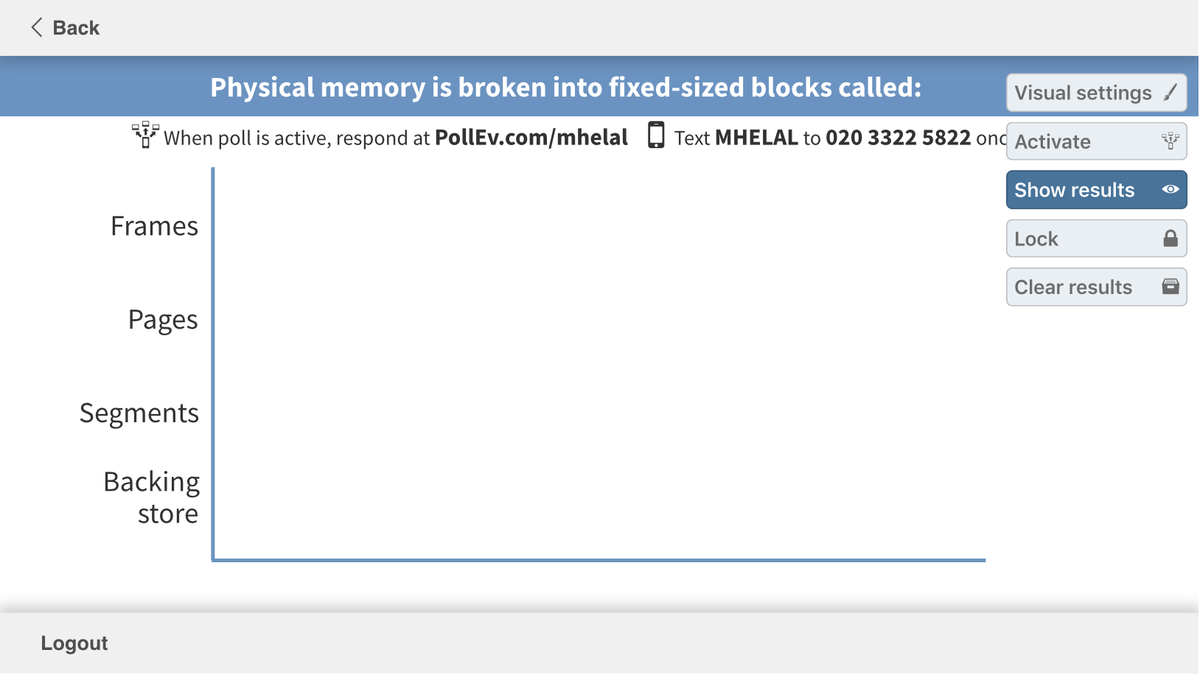

Slide 51
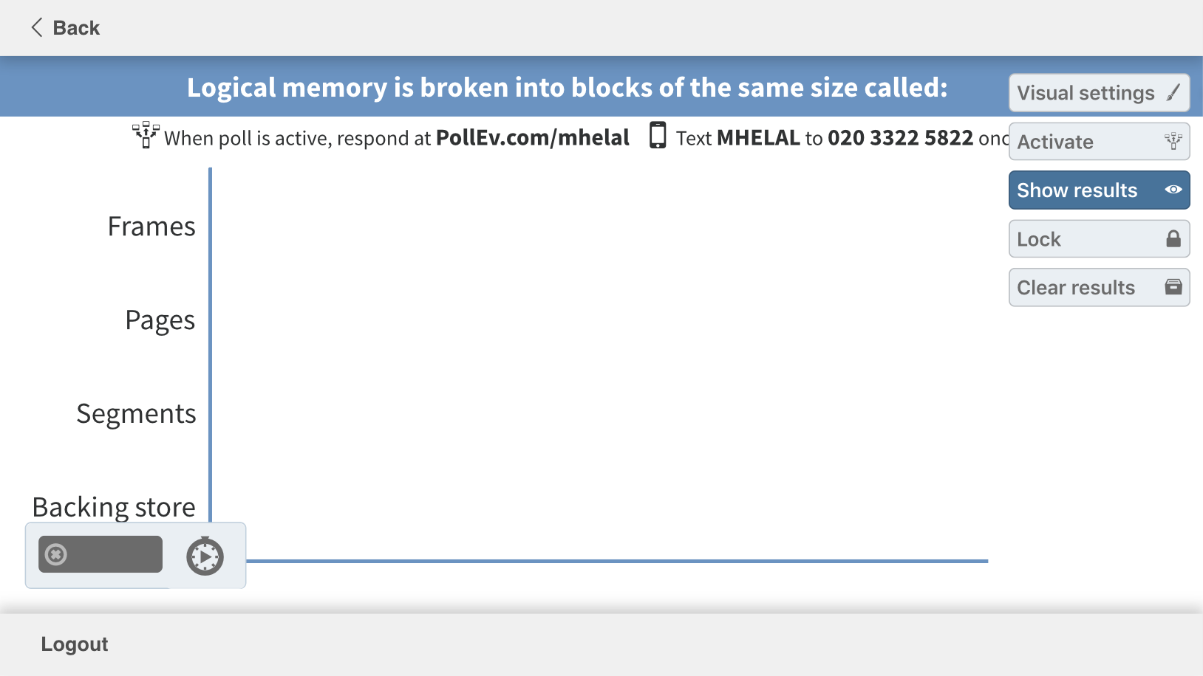

Slide 52
Break

Slide 53
Outline
Memory Definitions
  Stack vs. Heap
  Memory Hierarchy
Memory Management Requirements
  Relocation
  Protection
  Sharing
  Logical organization
  Physical organization
  Memory Partitioning
Virtual Memory
  Hardware and control Structures
  Segmentation
  Paging
  Protection and Sharing
Case Studies
Approximate number of clock cycles to access the memory element

Slide 54
Table 8.1 Virtual Memory Terminology
Notes:
Table 8.1 defines some key terms related to virtual memory.

Slide 55
Hardware and Control Structures
Two characteristics fundamental to memory management:
    All memory references are logical addresses that are dynamically translated into physical addresses at run time
    A process may be broken up into a number of pieces that don’t need to be contiguously located in main memory during execution
    If these two characteristics are present, it is not necessary that all of the pages or segments of a process be in main memory during execution
      More processes may be maintained in main memory
      A process may be larger than all of main memory
Notes:
Comparing simple paging and simple segmentation, on the one hand, with fixed and
dynamic partitioning, on the other, we see the foundation for a fundamental breakthrough
in memory management. Two characteristics of paging and segmentation
are the keys to this breakthrough:
1. All memory references within a process are logical addresses that are dynamically
translated into physical addresses at run time. This means that a process may be swapped in and out of main memory such that it occupies different
regions of main memory at different times during the course of execution.
2. A process may be broken up into a number of pieces (pages or segments) and
these pieces need not be contiguously located in main memory during execution.
The combination of dynamic run-time address translation and the use of
a page or segment table permits this.
Now we come to the breakthrough. If the preceding two characteristics are
present, then it is not necessary that all of the pages or all of the segments of a process
be in main memory during execution. If the piece (segment or page) that holds the
next instruction to be fetched and the piece that holds the next data location to be
accessed are in main memory, then at least for a time execution may proceed.
Implications:
More processes may be maintained in main memory
Because only some of the pieces of any particular process are loaded, there is room for more processes
This leads to more efficient utilization of the processor because it is more likely that at least one of the more numerous processes will be in a Ready state at any particular time
A process may be larger than all of main memory
If the program being written is too large, the programmer must devise ways to structure the program into pieces that can be loaded separately in some sort of overlay strategy
With virtual memory based on paging or segmentation, that job is left to the OS and the hardware
The OS automatically loads pieces of a process into main memory as required

Slide 56
Execution of a Process
Operating system brings into main memory a few pieces of the program
Resident set: Portion of process that is in main memory
An interrupt is generated when an address is needed that is not in main memory
Operating system places the process in a blocking state
Piece of process that contains the logical address is brought into main memory
    Operating system issues a disk I/O Read request
    Another process is dispatched to run while the disk I/O takes place
    An interrupt is issued when disk I/O is complete, which causes the operating system to place the affected process in the Ready state
Notes:
For now, we can talk in general
terms, and we will use the term piece to refer to either page or segment, depending
on whether paging or segmentation is employed. Suppose that it is time to bring a
new process into memory. The operating system begins by bringing in only one or
a few pieces, to include the initial program piece and the initial data piece to which
those instructions refer.
The portion of a process that is actually in main memory
at any time is defined to be the resident set of the process. As the process executes,
things proceed smoothly as long as all memory references are to locations that are
in the resident set. Using the segment or page table, the processor always is able to
determine whether this is so. If the processor encounters a logical address that is
not in main memory, it generates an interrupt indicating a memory access fault. The
operating system puts the interrupted process in a blocking state.
For the execution of this process to proceed later, the operating system will need to
bring into main memory the piece of the process that contains the logical address
that caused the access fault. For this purpose, the operating system issues a disk I/O
read request. After the I/O request has been issued, the operating system can dispatch
another process to run while the disk I/O is performed. Once the desired piece
has been brought into main memory, an I/O interrupt is issued, giving control back
to the operating system, which places the affected process back into a Ready state.

Slide 57
RAM
Diisk
Notes:
Figure 2.10 highlights the addressing concerns in a virtual memory scheme.
Storage consists of directly addressable (by machine instructions) main memory
and lower-speed auxiliary memory that is accessed indirectly by loading blocks
into main memory. Address translation hardware (memory management unit) is
interposed between the processor and memory. Programs reference locations using
virtual addresses, which are mapped into real main memory addresses. If a reference
is made to a virtual address not in real memory, then a portion of the contents
of real memory is swapped out to auxiliary memory and the desired block of data
is swapped in. During this activity, the process that generated the address reference
must be suspended. The OS designer needs to develop an address translation mechanism
that generates little overhead and a storage allocation policy that minimizes
the traffic between memory levels.
Because a process executes only in main memory, that memory is referred to
as real memory . But a programmer or user perceives a potentially much larger memory—
that which is allocated on disk. This latter is referred to as virtual memory .
Virtual memory allows for very effective multiprogramming and relieves the user
of the unnecessarily tight constraints of main memory.

Slide 58
Outline
Memory Definitions
  Stack vs. Heap
  Memory Hierarchy
Memory Management Requirements
  Relocation
  Protection
  Sharing
  Logical organization
  Physical organization
  Memory Partitioning
Virtual Memory
  Hardware and control Structures
  Segmentation
  Paging
  Protection and Sharing
Case Studies
Approximate number of clock cycles to access the memory element

Slide 59

Table 8.2
Characteristics of Paging and Segmentation
Notes:
Table 8.2 summarizes characteristics of paging and segmentation, with and without the use of virtual memory.

Slide 60
Thrashing
A state in which the system spends most of its time swapping process pieces rather than executing instructions
To avoid this, the operating system tries to guess, based on recent history, which pieces are least likely to be used in the near future
Notes:
To understand what the key issue is, and why virtual memory was a matter
of much debate, let us examine again the task of the operating system with respect
to virtual memory. Consider a large process, consisting of a long program plus a
number of arrays of data. Over any short period of time, execution may be confined
to a small section of the program (e.g., a subroutine) and access to perhaps only one
or two arrays of data. If this is so, then it would clearly be wasteful to load in dozens
of pieces for that process when only a few pieces will be used before the program is
suspended and swapped out. We can make better use of memory by loading in just a
few pieces. Then, if the program branches to an instruction or references a data item
on a piece not in main memory, a fault is triggered. This tells the operating system
to bring in the desired piece.
Thus, at any one time, only a few pieces of any given process are in memory,
and therefore more processes can be maintained in memory. Furthermore, time is
saved because unused pieces are not swapped in and out of memory. However, the
operating system must be clever about how it manages this scheme. In the steady
state, practically all of main memory will be occupied with process pieces, so that the
processor and operating system have direct access to as many processes as possible.
Thus, when the operating system brings one piece in, it must throw another out. If it
throws out a piece just before it is used, then it will just have to go get that piece again
almost immediately. Too much of this leads to a condition known as thrashing : The
system spends most of its time swapping pieces rather than executing instructions.
The avoidance of thrashing was a major research area in the 1970s and led to a variety
of complex but effective algorithms. In essence, the operating system tries to guess,
based on recent history, which pieces are least likely to be used in the near future.

Slide 61
Support Needed for Virtual Memory
For virtual memory to be practical and effective:
Hardware must support paging and segmentation
Operating system must include software for managing the movement of pages and/or segments between secondary memory and main memory
Notes:
The principle of locality suggests that a virtual memory
scheme may work. For virtual memory to be practical and effective, two ingredients
are needed. First, there must be hardware support for the paging and/or segmentation
scheme to be employed. Second, the operating system must include software
for managing the movement of pages and/or segments between secondary memory
and main memory.

Slide 62
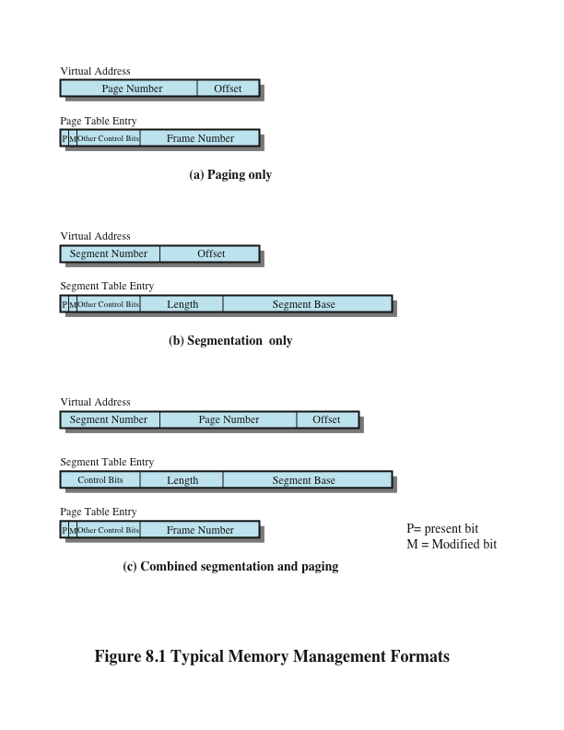
Paging
The term virtual memory is usually associated with systems that employ paging
Each process has its own page table
  Each page table entry (PTE) contains the frame number of the corresponding page in main memory
  Page is Present (P) in main memory
  Page is Modified (M)
  Can add protection bits
  A page table is also needed for a virtual memory scheme based on paging
Notes:
The term virtual memory is usually associated with systems that employ paging,
although virtual memory based on segmentation is also used and is discussed next.
The use of paging to achieve virtual memory was first reported for the Atlas computer
[KILB62] and soon came into widespread commercial use.
Because processes vary
in size, if the processor switches among a number of processes it is difficult to pack
them compactly into main memory. Paging systems were introduced, which allow
processes to be comprised of a number of fixed-size blocks, called pages. A program
references a word by means of a virtual address consisting of a page number
and an offset within the page. Each page of a process may be located anywhere
in main memory. The paging system provides for a dynamic mapping between the
virtual address used in the program and a real address , or physical address, in main
memory.
In the discussion of simple paging, we indicated that each process has its
own page table, and when all of its pages are loaded into main memory, the page table
for a process is created and loaded into main memory. Each page table entry
(PTE) contains the frame number of the corresponding page in main memory. A
page table is also needed for a virtual memory scheme based on paging.
Again, it is typical to associate a unique page table with each process. In this case, however,
the page table entries become more complex ( Figure 8.1a ). Because only some of
the pages of a process may be in main memory, a bit is needed in each page table
entry to indicate whether the corresponding page is present (P) in main memory or
not. If the bit indicates that the page is in memory, then the entry also includes the
frame number of that page.
The page table entry includes a modify (M) bit, indicating whether the contents
of the corresponding page have been altered since the page was last loaded
into main memory. If there has been no change, then it is not necessary to write the
page out when it comes time to replace the page in the frame that it currently occupies.
Other control bits may also be present. For example, if protection or sharing is
managed at the page level, then bits for that purpose will be required.

Slide 63
Translation Lookaside
Buffer (TLB)
Each virtual memory reference can cause two physical memory accesses:
  One to fetch the page table entry
  One to fetch the data
To overcome the effect of doubling the memory access time, most virtual memory schemes make use of a special high-speed cache called a translation lookaside buffer (TLB)
    This cache functions in the same way as a memory cache and contains those page table entities that have been most recently used
Notes:
In principle, every virtual memory reference
can cause two physical memory accesses: one to fetch the appropriate page table
entry and one to fetch the desired data. Thus, a straightforward virtual memory
scheme would have the effect of doubling the memory access time. To overcome
this problem, most virtual memory schemes make use of a special high-speed cache
for page table entries, usually called a translation lookaside buffer (TLB) . This
cache functions in the same way as a memory cache (see Chapter 1 ) and contains
those page table entries that have been most recently used.

Slide 64
Notes:
The organization of the resulting paging hardware is illustrated in Figure 8.6 . Given a virtual address,
the processor will first examine the TLB. If the desired page table entry is present
( TLB hit ), then the frame number is retrieved and the real address is formed. If the
desired page table entry is not found ( TLB miss ), then the processor uses the page
number to index the process page table and examine the corresponding page table
entry. If the “present bit” is set, then the page is in main memory, and the processor
can retrieve the frame number from the page table entry to form the real address.
The processor also updates the TLB to include this new page table entry. Finally,
if the present bit is not set, then the desired page is not in main memory and a
memory access fault, called a page fault , is issued. At this point, we leave the realm
of hardware and invoke the operating system, which loads the needed page and
updates the page table.

Slide 65
Page Size
The smaller the page size, the lesser the amount of internal fragmentation
    However, more pages are required per process
    More pages per process means larger page tables
    For large programs in a heavily multiprogrammed environment some portion of the page tables of active processes must be in virtual memory instead of main memory
    The physical characteristics of most secondary-memory devices favor a larger page size for more efficient block transfer of data
Notes:
An important hardware design decision is the size of page to be used.
There are several factors to consider. One is internal fragmentation. Clearly, the
smaller the page size, the lesser is the amount of internal fragmentation. To optimize
the use of main memory, we would like to reduce internal fragmentation. On the
other hand, the smaller the page, the greater is the number of pages required per
process. More pages per process means larger page tables. For large programs in
a heavily multiprogrammed environment, this may mean that some portion of the
page tables of active processes must be in virtual memory, not in main memory.
Thus, there may be a double page fault for a single reference to memory: first to
bring in the needed portion of the page table and second to bring in the process page.
Another factor is that the physical characteristics of most secondary-memory devices,
which are rotational, favor a larger page size for more efficient block transfer of data.
Complicating these matters is the effect of page size on the rate at which page
faults occur. This behavior, in general terms, is depicted in Figure 8.10a and is based
on the principle of locality. If the page size is very small, then ordinarily a relatively
large number of pages will be available in main memory for a process. After a time,
the pages in memory will all contain portions of the process near recent references.
Thus, the page fault rate should be low. As the size of the page is increased, each
individual page will contain locations further and further from any particular recent
reference. Thus the effect of the principle of locality is weakened and the page fault
rate begins to rise. Eventually, however, the page fault rate will begin to fall as the
size of a page approaches the size of the entire process (point P in the diagram).
When a single page encompasses the entire process, there will be no page faults.

Slide 66
Segmentation
Segmentation allows the programmer to view memory as consisting of multiple address spaces or segments
Advantages:
  Simplifies handling of growing data structures
  Allows programs to be altered and recompiled independently
  Lends itself to sharing data among processes
  Lends itself to protection
Notes:
Segmentation allows the programmer to view memory as consisting of multiple address spaces or segments.
Segments may be of unequal, indeed dynamic, size.
Memory references consist of a form of address (segment number, offset).
This organization has a number of advantages to the programmer over a nonsegmented address space:
It simplifies the handling of growing data structures.
If the programmer doesn’t know ahead of time how large a particular data structure will become, it is necessary to guess unless dynamic segment sizes are allowed. With segmented virtual memory, the data structure can be assigned its own segment, and the operating system will expand or shrink the segment as needed.
If a segment that needs to be expanded is in main memory and there is insufficient room, the operating system may move the segment to a larger area of main memory, if available, or swap it out. The enlarged segment would be swapped back in at the next opportunity.
2. It allows programs to be altered and recompiled independently,
without requiring the entire set of programs to be relinked and reloaded.
Again, this is accomplished using multiple segments.
3. It lends itself to sharing among processes.
A programmer can place a utility program or a useful table of data in a segment that can be referenced by other processes.
4. It lends itself to protection.
Because a segment can be constructed to contain a well-defined set of programs or data, the programmer or system administrator can assign access privileges in a convenient fashion.

Slide 67
Combined Paging and Segmentation
In a combined paging/segmentation system a user’s address space is broken up into a number of segments. Each segment is broken up into a number of fixed-sized pages which are equal in length to a main memory frame
Segmentation is visible to the programmer
Paging is transparent to the programmer
Notes:
Both paging and segmentation have their strengths. Paging, which is transparent
to the programmer, eliminates external fragmentation and thus provides efficient
use of main memory. In addition, because the pieces that are moved in and out of
main memory are of fixed, equal size, it is possible to develop sophisticated memory
management algorithms that exploit the behavior of programs, as we shall see.
Segmentation, which is visible to the programmer, has the strengths listed earlier,
including the ability to handle growing data structures, modularity, and support
for sharing and protection. To combine the advantages of both, some systems are
equipped with processor hardware and operating system software to provide both.
In a combined paging/segmentation system, a user’s address space is broken
up into a number of segments, at the discretion of the programmer. Each segment
is, in turn, broken up into a number of fixed-size pages, which are equal in length to
a main memory frame. If a segment has length less than that of a page, the segment
occupies just one page. From the programmer’s point of view, a logical address still
consists of a segment number and a segment offset. From the system’s point of view,
the segment offset is viewed as a page number and page offset for a page within the
specified segment.

Slide 68
Notes:
Figure 8.12 suggests a structure to support combined paging/segmentation
(note similarity to Figure 8.4 ). Associated with each process is a segment table and
a number of page tables, one per process segment. When a particular process is
running, a register holds the starting address of the segment table for that process.
Presented with a virtual address, the processor uses the segment number portion to
index into the process segment table to find the page table for that segment. Then
the page number portion of the virtual address is used to index the page table and
look up the corresponding frame number. This is combined with the offset portion
of the virtual address to produce the desired real address.

Slide 69
Protection and Sharing
Segmentation lends itself to the implementation of protection and sharing policies
Each entry has a base address and length so inadvertent memory access can be controlled
Sharing can be achieved by segments referencing multiple processes
Notes:
Segmentation lends itself to the implementation of protection and sharing policies.
Because each segment table entry includes a length as well as a base address, a program
cannot inadvertently access a main memory location beyond the limits of a
segment. To achieve sharing, it is possible for a segment to be referenced in the segment
tables of more than one process. The same mechanisms are, of course, available
in a paging system. However, in this case the page structure of programs and
data is not visible to the programmer, making the specification of protection and
sharing requirements more awkward.

Slide 70
Notes:
Figure 8.13 illustrates the types of protection relationships that can be enforced in such a system.
More sophisticated mechanisms can also be provided. A common scheme is
to use a ring-protection structure, of the type we referred to in Chapter 3 ( Figure
3.18 ). In this scheme, lower-numbered, or inner, rings enjoy greater privilege than
higher-numbered, or outer, rings. Typically, ring 0 is reserved for kernel functions
of the operating system, with applications at a higher level. Some utilities or operating
system services may occupy an intermediate ring. Basic principles of the ring
system are as follows:
1. A program may access only data that reside on the same ring or a less privileged
ring.
2. A program may call services residing on the same or a more privileged ring.

Slide 71
Operating System Software
The design of the memory management portion of an operating system depends on three fundamental areas of choice:
Whether or not to use virtual memory techniques
The use of paging or segmentation or both
The algorithms employed for various aspects of memory management
Notes:
The design of the memory management portion of an operating system depends on
three fundamental areas of choice:
• Whether or not to use virtual memory techniques
• The use of paging or segmentation or both
• The algorithms employed for various aspects of memory management
The choices made in the first two areas depend on the hardware platform available.
Thus, earlier UNIX implementations did not provide virtual memory because the
processors on which the system ran did not support paging or segmentation. Neither
of these techniques is practical without hardware support for address translation
and other basic functions.
Two additional comments about the first two items in the preceding list: First,
with the exception of operating systems for some of the older personal computers,
such as MS-DOS, and specialized systems, all important operating systems provide
virtual memory. Second, pure segmentation systems are becoming increasingly rare.
When segmentation is combined with paging, most of the memory management
issues confronting the operating system designer are in the area of paging. Thus,
we can concentrate in this section on the issues associated with paging.
The choices related to the third item are the domain of operating system software
and are the subject of this section.

Slide 72
Table 8.4 Operating System Policies for Virtual Memory
Notes:
Table 8.4 lists the key design elements that
we examine. In each case, the key issue is one of performance: We would like to
minimize the rate at which page faults occur, because page faults cause considerable
software overhead. At a minimum, the overhead includes deciding which resident
page or pages to replace, and the I/O of exchanging pages. Also, the operating system
must schedule another process to run during the page I/O, causing a process
switch. Accordingly, we would like to arrange matters so that, during the time that
a process is executing, the probability of referencing a word on a missing page is
minimized. In all of the areas referred to in Table 8.4 , there is no definitive policy
that works best.
As we shall see, the task of memory management in a paging environment
is fiendishly complex. Furthermore, the performance of any particular set
of policies depends on main memory size, the relative speed of main and secondary
memory, the size and number of processes competing for resources, and the execution
behavior of individual programs. This latter characteristic depends on the nature
of the application, the programming language and compiler employed, the style of
the programmer who wrote it, and, for an interactive program, the dynamic behavior
of the user. Thus, the reader must expect no final answers here or anywhere. For
smaller systems, the operating system designer should attempt to choose a set of policies
that seems “good” over a wide range of conditions, based on the current state of
knowledge. For larger systems, particularly mainframes, the operating system should
be equipped with monitoring and control tools that allow the site manager to tune
the operating system to get “good” results based on site conditions.
The fetch policy determines when a page should be brought into main memory. The
two common alternatives are demand paging and prepaging.
Demand Paging
Only brings pages into main memory when a reference is made to a location on the page
Many page faults when process is first started
Principle of locality suggests that as more and more pages are brought in, most future references will be to pages that have recently been brought in, and page faults should drop to a very low level
With prepaging , pages other than the one demanded by a page fault are
brought in. Prepaging exploits the characteristics of most secondary memory
devices, such as disks, which have seek times and rotational latency. If the pages of
a process are stored contiguously in secondary memory, then it is more efficient to
bring in a number of contiguous pages at one time rather than bringing them in one
at a time over an extended period. Of course, this policy is ineffective if most of the
extra pages that are brought in are not referenced.
The prepaging policy could be employed either when a process first starts up,
in which case the programmer would somehow have to designate desired pages, or
every time a page fault occurs. This latter course would seem preferable because
it is invisible to the programmer.
Prepaging should not be confused with swapping. When a process is swapped
out of memory and put in a suspended state, all of its resident pages are moved out.
When the process is resumed, all of the pages that were previously in main memory
are returned to main memory.
The placement policy determines where in real memory a process piece is to reside.
In a pure segmentation system, the placement policy is an important design issue;
policies such as best-fit, first-fit, and so on, which were discussed in Chapter 7 , are
possible alternatives. However, for a system that uses either pure paging or paging
combined with segmentation, placement is usually irrelevant because the address
translation hardware and the main memory access hardware can perform their
functions for any page-frame combination with equal efficiency.
There is one area in which placement does become a concern, and this is a
subject of research and development. On a so-called nonuniform memory access
(NUMA) multiprocessor, the distributed, shared memory of the machine can be
referenced by any processor on the machine, but the time for accessing a particular
physical location varies with the distance between the processor and the memory
module. Thus, performance depends heavily on the extent to which data reside
close to the processors that use them [LARO92, BOLO89, COX89]. For NUMA
systems, an automatic placement strategy is desirable to assign pages to the memory
module that provides the best performance.
In most operating system texts, the treatment of memory management includes a
section entitled “replacement policy,” which deals with the selection of a page in
main memory to be replaced when a new page must be brought in. This topic is
sometimes difficult to explain because several interrelated concepts are involved:
• How many page frames are to be allocated to each active process
• Whether the set of pages to be considered for replacement should be limited
to those of the process that caused the page fault or encompass all the page
frames in main memory
• Among the set of pages considered, which particular page should be selected
for replacement
We shall refer to the first two concepts as resident set management , which is dealt
with in the next subsection, and reserve the term replacement policy for the third
concept, which is discussed in this subsection.
The area of replacement policy is probably the most studied of any area of
memory management. When all of the frames in main memory are occupied and
it is necessary to bring in a new page to satisfy a page fault, the replacement policy
determines which page currently in memory is to be replaced. All of the policies
have as their objective that the page that is removed should be the page least likely
to be referenced in the near future. Because of the principle of locality, there is
often a high correlation between recent referencing history and near-future referencing
patterns. Thus, most policies try to predict future behavior on the basis of
past behavior. One trade-off that must be considered is that the more elaborate and
sophisticated the replacement policy, the greater will be the hardware and software
overhead to implement it.
Regardless of the resident set management strategy (discussed
in the next subsection), there are certain basic algorithms that are used for the
selection of a page to replace. Replacement algorithms that have been discussed in
the literature include
• Optimal
• Least recently used (LRU)
• First-in-first-out (FIFO)
• Clock
The optimal policy selects for replacement that page for which the time to the next
reference is the longest. It can be shown that this policy results in the fewest number of
page faults [BELA66]. Clearly, this policy is impossible to implement, because it would
require the operating system to have perfect knowledge of future events. However, it
does serve as a standard against which to judge real-world algorithms.
Figure 8.14 gives an example of the optimal policy. The example assumes a
fixed frame allocation (fixed resident set size) for this process of three frames. The
execution of the process requires reference to five distinct pages. The page address
stream formed by executing the program is
2 3 2 1 5 2 4 5 3 2 5 2
which means that the first page referenced is 2, the second page referenced is 3, and
so on. The optimal policy produces three page faults after the frame allocation has
been filled.
The least recently used (LRU) policy replaces the page in memory that has
not been referenced for the longest time. By the principle of locality, this should
be the page least likely to be referenced in the near future. And, in fact, the LRU
policy does nearly as well as the optimal policy. The problem with this approach is
the difficulty in implementation. One approach would be to tag each page with the
time of its last reference; this would have to be done at each memory reference,
both instruction and data. Even if the hardware would support such a scheme, the
overhead would be tremendous. Alternatively, one could maintain a stack of page
references, again an expensive prospect.
The first-in-first-out (FIFO) policy treats the page frames allocated to a process
as a circular buffer, and pages are removed in round-robin style. All that is
required is a pointer that circles through the page frames of the process. This is
therefore one of the simplest page replacement policies to implement. The logic
behind this choice, other than its simplicity, is that one is replacing the page that
has been in memory the longest: A page fetched into memory a long time ago may
have now fallen out of use. This reasoning will often be wrong, because there will
often be regions of program or data that are heavily used throughout the life of a
program. Those pages will be repeatedly paged in and out by the FIFO algorithm.
The simplest form of clock policy requires the association of an additional
bit with each frame, referred to as the use bit. When a page is first loaded into a
frame in memory, the use bit for that frame is set to 1. Whenever the page is subsequently
referenced (after the reference that generated the page fault), its use bit is
set to 1. For the page replacement algorithm, the set of frames that are candidates
for replacement (this process: local scope; all of main memory: global scope ) is
considered to be a circular buffer, with which a pointer is associated. When a page
is replaced, the pointer is set to indicate the next frame in the buffer after the one
just updated. When it comes time to replace a page, the operating system scans
the buffer to find a frame with a use bit set to 0. Each time it encounters a frame
with a use bit of 1, it resets that bit to 0 and continues on. If any of the frames in
the buffer have a use bit of 0 at the beginning of this process, the first such frame
encountered is chosen for replacement. If all of the frames have a use bit of 1, then
the pointer will make one complete cycle through the buffer, setting all the use bits
to 0, and stop at its original position, replacing the page in that frame. We can see
that this policy is similar to FIFO, except that, in the clock policy, any frame with
a use bit of 1 is passed over by the algorithm. The policy is referred to as a clock
policy because we can visualize the page frames as laid out in a circle. A number of
operating systems have employed some variation of this simple clock policy (e.g.,
Multics [CORB68]).
Although LRU and the clock policies are superior to FIFO,
they both involve complexity and overhead not suffered with FIFO. In addition,
there is the related issue that the cost of replacing a page that has been modified is
greater than for one that has not, because the former must be written back out to
secondary memory.
An interesting strategy that can improve paging performance and allow
the use of a simpler page replacement policy is page buffering. The VAX VMS
approach is representative. The page replacement algorithm is simple FIFO. To
improve performance, a replaced page is not lost but rather is assigned to one of
two lists: the free page list if the page has not been modified, or the modified page
list if it has. Note that the page is not physically moved about in main memory;
instead, the entry in the page table for this page is removed and placed in either the
free or modified page list.
The free page list is a list of page frames available for reading in pages. VMS
tries to keep some small number of frames free at all times. When a page is to be
read in, the page frame at the head of the list is used, destroying the page that was
there. When an unmodified page is to be replaced, it remains in memory and its
page frame is added to the tail of the free page list. Similarly, when a modified page
is to be written out and replaced, its page frame is added to the tail of the modified
page list.
The important aspect of these maneuvers is that the page to be replaced
remains in memory. Thus if the process references that page, it is returned to the
resident set of that process at little cost. In effect, the free and modified page lists act
as a cache of pages. The modified page list serves another useful function: Modified
pages are written out in clusters rather than one at a time. This significantly reduces
the number of I/O operations and therefore the amount of disk access time.
A simpler version of page buffering is implemented in the Mach operating
system [RASH88]. In this case, no distinction is made between modified and
unmodified pages.
As discussed earlier, main memory size
is getting larger and the locality of applications is decreasing. In compensation,
cache sizes have been increasing. Large cache sizes, even multimegabyte ones, are
now feasible design alternatives [BORG90]. With a large cache, the replacement of
virtual memory pages can have a performance impact. If the page frame selected
for replacement is in the cache, then that cache block is lost as well as the page that
it holds.
In systems that use some form of page buffering, it is possible to improve
cache performance by supplementing the page replacement policy with a policy for
page placement in the page buffer. Most operating systems place pages by selecting
an arbitrary page frame from the page buffer; typically a first-in-first-out discipline
is used. A study reported in [KESS92] shows that a careful page placement strategy
can result in 10–20% fewer cache misses than naive placement.
Several page placement algorithms are examined in [KESS92]. The details
are beyond the scope of this book, as they depend on the details of cache structure
and policies. The essence of these strategies is to bring consecutive pages into main
memory in such a way as to minimize the number of page frames that are mapped
into the same cache slots.
With paged virtual memory, it is not necessary and indeed
may not be possible to bring all of the pages of a process into main memory to
prepare it for execution. Thus, the operating system must decide how many pages to
bring in, that is, how much main memory to allocate to a particular process. Several
factors come into play:
• The smaller the amount of memory allocated to a process, the more processes
that can reside in main memory at any one time. This increases the probability
that the operating system will find at least one ready process at any given time
and hence reduces the time lost due to swapping.
• If a relatively small number of pages of a process are in main memory, then,
despite the principle of locality, the rate of page faults will be rather high (see
Figure 8.10b ).
• Beyond a certain size, additional allocation of main memory to a particular
process will have no noticeable effect on the page fault rate for that process
because of the principle of locality.
With these factors in mind, two sorts of policies are to be found in contemporary
operating systems. A fixed-allocation policy gives a process a fixed number of
frames in main memory within which to execute. That number is decided at initial
load time (process creation time) and may be determined based on the type of process
(interactive, batch, type of application) or may be based on guidance from the
programmer or system manager. With a fixed-allocation policy, whenever a page
fault occurs in the execution of a process, one of the pages of that process must be
replaced by the needed page.
A variable-allocation policy allows the number of page frames allocated to a
process to be varied over the lifetime of the process. Ideally, a process that is suffering
persistently high levels of page faults, indicating that the principle of locality
only holds in a weak form for that process, will be given additional page frames
to reduce the page fault rate; whereas a process with an exceptionally low page
fault rate, indicating that the process is quite well behaved from a locality point of
view, will be given a reduced allocation, with the hope that this will not noticeably
increase the page fault rate. The use of a variable-allocation policy relates to the
concept of replacement scope, as explained in the next subsection.
The variable-allocation policy would appear to be the more powerful one.
However, the difficulty with this approach is that it requires the operating system to
assess the behavior of active processes. This inevitably requires software overhead
in the operating system and is dependent on hardware mechanisms provided by the
processor platform.
The scope of a replacement strategy can be categorized as
global or local. Both types of policies are activated by a page fault when there are no
free page frames. A local replacement policy chooses only among the resident pages
of the process that generated the page fault in selecting a page to replace. A global
replacement policy considers all unlocked pages in main memory as candidates for
replacement, regardless of which process owns a particular page. While it happens
that local policies are easier to analyze, there is no convincing evidence that they
perform better than global policies, which are attractive because of their simplicity
of implementation and minimal overhead [CARR81, MAEK87].
There is a correlation between replacement scope and resident set size
( Table 8.5 ). A fixed resident set implies a local replacement policy: To hold the size
of a resident set fixed, a page that is removed from main memory must be replaced
by another page from the same process. A variable-allocation policy can clearly
employ a global replacement policy: The replacement of a page from one process in
main memory with that of another causes the allocation of one process to grow by
one page and that of the other to shrink by one page. We shall also see that variable
allocation and local replacement is a valid combination. We now examine these
three combinations.
A cleaning policy is the opposite of a fetch policy; it is concerned with determining
when a modified page should be written out to secondary memory. Two common
alternatives are demand cleaning and precleaning. With demand cleaning , a page is
written out to secondary memory only when it has been selected for replacement.
A precleaning policy writes modified pages before their page frames are needed so
that pages can be written out in batches.
Both precleaning and demand cleaning have drawbacks. With precleaning, a
page is written out but remains in main memory until the page replacement algorithm
dictates that it be removed. Precleaning allows the writing of pages in batches,
but it makes little sense to write out hundreds or thousands of pages only to find
that the majority of them have been modified again before they are replaced. The
transfer capacity of secondary memory is limited and should not be wasted with
unnecessary cleaning operations.
On the other hand, with demand cleaning, the writing of a dirty page is coupled
to, and precedes, the reading in of a new page. This technique may minimize
page writes, but it means that a process that suffers a page fault may have to wait
for two page transfers before it can be unblocked. This may decrease processor
utilization.
A better approach incorporates page buffering. This allows the adoption of the
following policy: Clean only pages that are replaceable, but decouple the cleaning
and replacement operations. With page buffering, replaced pages can be placed on
two lists: modified and unmodified. The pages on the modified list can periodically
be written out in batches and moved to the unmodified list. A page on the unmodified
list is either reclaimed if it is referenced or lost when its frame is assigned to
another page.
Load control is concerned with determining the number of processes that will be resident
in main memory, which has been referred to as the multiprogramming level. The
load control policy is critical in effective memory management. If too few processes
are resident at any one time, then there will be many occasions when all processes
are blocked, and much time will be spent in swapping. On the other hand, if too
many processes are resident, then, on average, the size of the resident set of each
process will be inadequate and frequent faulting will occur. The result is thrashing.

Slide 73
Frame Locking
When a frame is locked the page currently stored in that frame may not be replaced
  Kernel of the OS as well as key control structures are held in locked frames
  I/O buffers and time-critical areas may be locked into main memory frames
  Locking is achieved by associating a lock bit with each frame
Notes:
One restriction on replacement policy needs to be mentioned
before looking at various algorithms: Some of the frames in main memory may be
locked. When a frame is locked, the page currently stored in that frame may not be
replaced. Much of the kernel of the OS, as well as key control structures, are held in
locked frames. In addition, I/O buffers and other time-critical areas may be locked
into main memory frames. Locking is achieved by associating a lock bit with each
frame. This bit may be kept in a frame table as well as being included in the current
page table.

Slide 74
Outline
Memory Definitions
  Stack vs. Heap
  Memory Hierarchy
Memory Management Requirements
  Relocation
  Protection
  Sharing
  Logical organization
  Physical organization
  Memory Partitioning
Virtual Memory
  Hardware and control Structures
  Segmentation
  Paging
  Protection and Sharing
Case Studies
Approximate number of clock cycles to access the memory element

Slide 75
UNIX
Intended to be machine independent so its memory management schemes will vary
  Early UNIX: variable partitioning with no virtual memory scheme
  Current implementations of UNIX and Solaris make use of paged virtual memory
SVR4 and Solaris use two separate schemes:
Paging system
Kernel memory allocator
Notes:
Because UNIX is intended to be machine independent, its memory management
scheme will vary from one system to the next. Earlier versions of UNIX simply used
variable partitioning with no virtual memory scheme. Current implementations of
UNIX and Solaris make use of paged virtual memory.
In SVR4 and Solaris, there are actually two separate memory management
schemes.
The paging system provides a virtual memory capability that allocates
page frames in main memory to processes and also allocates page frames to disk
block buffers. Although this is an effective memory management scheme for user
processes and disk I/O, a paged virtual memory scheme is less suited to managing
the memory allocation for the kernel. For this latter purpose, a kernel memory
allocator is used.

Slide 76
Table 8.6
UNIX SVR4 Memory Management Parameters
(page 1 of 2)
(Table can be found on page 381 in the textbook)
Notes:
For paged virtual memory, UNIX makes use of a number of
data structures that, with minor adjustment, are machine independent ( Figure 8.22
and Table 8.6 ):
Page table : Typically, there will be one page table per process, with one entry
for each page in virtual memory for that process.
• Disk block descriptor: Associated with each page of a process is an entry in
this table that describes the disk copy of the virtual page.
• Page frame data table: Describes each frame of real memory and is indexed by
frame number. This table is used by the replacement algorithm.
• Swap-use table: There is one swap-use table for each swap device, with one
entry for each page on the device.
Most of the fields defined in Table 8.6 are self-explanatory. A few warrant
further comment. The Age field in the page table entry is an indication of how long
it has been since a program referenced this frame. However, the number of bits
and the frequency of update of this field are implementation dependent. Therefore,
there is no universal UNIX use of this field for page replacement policy.
The Type of Storage field in the disk block descriptor is needed for the
following reason: When an executable file is first used to create a new process, only
a portion of the program and data for that file may be loaded into real memory.
Later, as page faults occur, new portions of the program and data are loaded. It is
only at the time of first loading that virtual memory pages are created and assigned
to locations on one of the devices to be used for swapping. At that time, the operating
system is told whether it needs to clear (set to 0) the locations in the page frame
before the first loading of a block of the program or data.

Slide 77
Table 8.6
UNIX SVR4 Memory Management Parameters
(page 2 of 2)
(Table can be found on page 381 in the textbook)
Notes:
Table 8.6 (continued)

Slide 78
Page Replacement
The page frame data table is used for page replacement
Pointers are used to create lists within the table
    All available frames are linked together in a list of free frames available for bringing in pages
    When the number of available frames drops below a certain threshold, the kernel will steal a number of frames to compensate
Notes:
The page frame data table is used for page replacement.
Several pointers are used to create lists within this table. All of the available frames
are linked together in a list of free frames available for bringing in pages. When the
number of available frames drops below a certain threshold, the kernel will steal a
number of frames to compensate.

Slide 79
Linux
Memory Management
Shares many characteristics with UNIX
Is quite complex
Two main aspects
Process virtual memory
Kernel memory allocation
Notes:
Linux shares many of the characteristics of the memory management schemes of
other UNIX implementations but has its own unique features. Overall, the Linux
memory management scheme is quite complex [DUBE98].

Slide 80
Linux Virtual Memory
Three level page table structure:
Page directory
Process has a single page directory
Each entry points to one page of the page middle directory
Must be in main memory for an active process
Page middle directory
May span multiple pages
Each entry points to one page in the page table
Page table
May also span multiple pages
Each entry refers to one virtual page of the process
Notes:
Linux makes use of a three-level page table
structure, consisting of the following types of tables (each individual table is the size
of one page):
• Page directory: An active process has a single page directory that is the size
of one page. Each entry in the page directory points to one page of the page
middle directory. The page directory must be in main memory for an active
process.
Page middle directory: The page middle directory may span multiple pages.
Each entry in the page middle directory points to one page in the page table.
• Page table: The page table may also span multiple pages. Each page table
entry refers to one virtual page of the process.

Slide 81
Notes:
To use this three-level page table structure, a virtual address in Linux is viewed
as consisting of four fields ( Figure 8.23 ). The leftmost (most significant) field is used
as an index into the page directory. The next field serves as an index into the page
middle directory. The third field serves as an index into the page table. The fourth
field gives the offset within the selected page of memory.
The Linux page table structure is platform independent and was designed to
accommodate the 64-bit Alpha processor, which provides hardware support for
three levels of paging. With 64-bit addresses, the use of only two levels of pages on
the Alpha would result in very large page tables and directories. The 32-bit
x86 architecture has a two-level hardware paging mechanism. The Linux software
accommodates the two-level scheme by defining the size of the page middle directory
as one. Note that all references to an extra level of indirection are optimized
away at compile time, not at run time. Therefore, there is no performance overhead
for using generic three-level design on platforms which support only two levels in
hardware.

Slide 82
Linux Page Replacement
Based on the clock algorithm
The use bit is replaced with an 8-bit age variable
    Incremented each time the page is accessed
Periodically decrements the age bits
    A page with an age of 0 is an “old” page that has not been referenced in some time and is the best candidate for replacement
A form of least frequently used policy
Notes:
Prior to Linux release 2.6.28, the Linux page
replacement algorithm was based on the clock algorithm described in Section 8.2 (see
Figure 8.15). In the simple clock algorithm, a use bit and a modify bit are associated
with each page in main memory. In the Linux scheme, the use bit was replaced with an
8-bit age variable. Each time that a page is accessed, the age variable is incremented.
In the background, Linux periodically sweeps through the global page pool and
decrements the age variable for each page as it rotates through all the pages in main
memory. A page with an age of 0 is an “old” page that has not been referenced in
some time and is the best candidate for replacement. The larger the value of age, the
more frequently a page has been used in recent times and the less eligible it is for
replacement. Thus, the Linux algorithm was a form of least frequently used policy.

Slide 83
Notes:
We can summarize the steps involved in page management as follows (Figure 8.24):
1. The first time a page on the inactive list is accessed, the PG_referenced flag
is set.
2. The next time that page is accessed, it is moved to the active list. That is, it
takes two accesses for a page to be declared active. More precisely, it takes two
accesses in different scans for a page to become active.
3. If the second access doesn’t happen soon enough, PG_referenced is reset.
4. Similarly, for active pages, two timeouts are required to move the page to the
inactive list.
Pages on the inactive list are then available for page replacement, using an
LRU type of algorithm.

Slide 84
Windows
Memory Management
Virtual memory manager controls how memory is allocated and how paging is performed
Designed to operate over a variety of platforms
Uses page sizes ranging from 4 Kbytes to 64 Kbytes
Notes:
The Windows virtual memory manager controls how memory is allocated and how
paging is performed. The memory manager is designed to operate over a variety
of platforms and to use page sizes ranging from 4 Kbytes to 64 Kbytes. Intel
and AMD64 platforms have 4 Kbytes per page and Intel Itanium platforms have
8 Kbytes per page.

Slide 85
Windows Virtual Address Map
On 32 bit platforms each user process sees a separate 32 bit address space allowing 4 GB of virtual memory per process
    By default half is reserved for the OS
    Large memory intensive applications run more effectively using 64-bit Windows
    Most modern PCs use the AMD64 processor architecture which is capable of running as either a 32-bit or 64-bit system
Notes:
On 32-bit platforms, each Windows user process sees a separate 32-bit address
space, allowing 4 GB of virtual memory per process. By default, half of this
memory is reserved for the operating system, so each user actually has 2 GB of
available virtual address space and all processes share most of the upper 2 GB of
system space when running in kernel-mode. Large memory intensive applications,
on both clients and servers, can run more effectively using 64-bit Windows. Other
than netbooks, most modern PCs use the AMD64 processor architecture which is
capable of running as either a 32-bit or 64-bit system.
Figure 8.25 shows the default virtual address space seen by a normal 32-bit
user process. It consists of four regions:
• 0x00000000 to 0x0000FFFF: Set aside to help programmers catch NULLpointer
assignments.
• 0x00010000 to 0x7FFEFFFF: Available user address space. This space is
divided into pages that may be loaded into main memory.
• 0x7FFF0000 to 0x7FFFFFFF: A guard page inaccessible to the user. This page
makes it easier for the operating system to check on out-of-bounds pointer
references.
• 0x80000000 to 0xFFFFFFFF: System address space. This 2-GB process is
used for the Windows Executive, Kernel, HAL, and device drivers.
• On 64-bit platforms, 8 TB of user address space is available in Windows.

Slide 86
Windows Paging
On creation, a process can make use of the entire user space of almost 2 GB
This space is divided into fixed-size pages managed in contiguous regions allocated on 64 KB boundaries
Regions may be in one of three states:
Available
Reserved
Committed
Notes:
When a process is created, it can in principle make use of the entire user space of
almost 2 GB (or 8 TB on 64-bit Windows). This space is divided into fixed size
pages, any of which can be brought into main memory, but the OS
manages the addresses in contiguous regions allocated on 64-KB boundaries. A
region can be in one of three states:
• Available: addresses not currently used by this process.
• Reserved: addresses that the virtual memory manager has set aside for a process
so they cannot be allocated to another use (e.g., saving contiguous space
for a stack to grow).
• Committed: addresses that the virtual memory manager has initialized for use
by the process to access virtual memory pages. These pages can reside either
on disk or in physical memory. When on disk they can be either kept in files
(mapped pages) or occupy space in the paging file (i.e., the disk file to which it
writes pages when removing them from main memory).
The distinction between reserved and committed memory is useful because
it (1) reduces the amount of total virtual memory space needed by the system,
allowing the page file to be smaller; and (2) allows programs to reserve addresses
without making them accessible to the program or having them charged against
their resource quotas.

Slide 87
Android Memory Management
Android includes a number of extensions to the normal Linux kernel memory management facility
These include:
  ASHMem
      This feature provides anonymous shared memory, which abstracts memory as file descriptors
      A file descriptor can be passed to another process to share memory
  Pmem
      This feature allocates virtual memory so that it is physically contiguous
      This feature is useful for hardware that does not support virtual memory
  Low Memory Killer
      This feature enables the system to notify an app or apps that they need to free up memory
      If an app does not cooperate, it is terminated
The Android Runtime (ART) and Dalvik virtual machine use paging and memory-mapping (mmapping) to manage memory:
  Any memory an app modifies remains resident in RAM and cannot be paged out.
  Apps need to release object references that the app holds, making the memory available to the garbage collector.
https://developer.android.com/topic/performance/memory-overview
Notes:
Android includes a number of extensions to the normal Linux kernel memory management
facility. These include the following:
• ASHMem: This feature provides anonymous shared memory, which abstracts
memory as file descriptors. A file descriptor can be passed to another process
to share memory.
• Pmem: This feature allocates virtual memory so that it is physically contiguous.
This feature is useful for hardware that does not support virtual memory.
• Low Memory Killer: Most mobile devices do not have a swap capability (because
of flash memory lifetime considerations). When main memory is exhausted,
the application or applications using the most memory must either
back off their use of memory or be terminated. This feature enables the system
to notify an app or apps that they need to free up memory. If an app does not
cooperate, it is terminated.

Slide 88
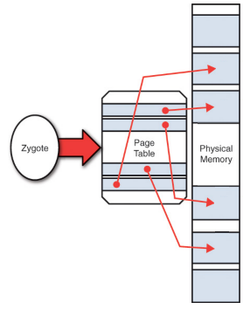
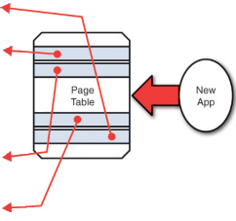
Android Copy on Write

Slide 89
Android App Memory Management
To help balance the system memory and avoid the system's need to kill your app process, you can implement the ComponentCallbacks2 interface in your Activity classes.
The provided onTrimMemory() callback method allows your app to listen for memory related events when your app is in either the foreground or the background, and then release objects in response to app lifecycle or system events that indicate the system needs to reclaim memory.
public void onTrimMemory(int level) {
switch (level) {
case ComponentCallbacks2.TRIM_MEMORY_UI_HIDDEN:
break;
case ComponentCallbacks2.TRIM_MEMORY_RUNNING_MODERATE:
case ComponentCallbacks2.TRIM_MEMORY_RUNNING_LOW:
case ComponentCallbacks2.TRIM_MEMORY_RUNNING_CRITICAL:
break;
case ComponentCallbacks2.TRIM_MEMORY_BACKGROUND:
case ComponentCallbacks2.TRIM_MEMORY_MODERATE:
case ComponentCallbacks2.TRIM_MEMORY_COMPLETE:
default:
break;
}
}
public void doSomethingMemoryIntensive() {
// Before doing something that requires a lot of memory,
// check to see whether the device is in a low memory state.
ActivityManager.MemoryInfo memoryInfo = getAvailableMemory();
if (!memoryInfo.lowMemory) {
// Do memory intensive work ...
}
}
// Get a MemoryInfo object for the device's current memory status.
private ActivityManager.MemoryInfo getAvailableMemory() {
ActivityManager activityManager = (ActivityManager)
this.getSystemService(ACTIVITY_SERVICE);
ActivityManager.MemoryInfo memoryInfo = new
ActivityManager.MemoryInfo();
activityManager.getMemoryInfo(memoryInfo);
return memoryInfo;
}

